Slide 1

Dengue Prediction
W205 Project Progress Presentation
Felipe Campos
Frank Shannon
Josh Wilson
Matthew Holmes
August 1, 2017

Slide 2
Overview of Dengue Fever Forecast Modeling
Early Warning System (EWS)
Real-time forecast based on autoregressive modeling of historical climate conditions and Dengue Fever case counts
Factors that could be potentially included in model:
Complex transmission dynamics (“herd” immunity, population crowding, viral and mosquito incubation times)
Interplay of environmental and social factors (adequate housing, “pipeline” water supply, hospital access)
Interaction of different dengue serotypes (seasonal serotype predominance, re-exposure)
Climate factors (rainfall, lowest temperature, mean temperature, humidity) are most consistent predictors of endemic and epidemic DF prevalence
ENSO - El Nino Southern Oscillation is responsible for recent epidemics
Global warming is shifting favorable climate conditions further North
Regional differences in DF susceptibility result from spatial climate and environmental differences
Brazil has the highest prevalence of DF and the most geographical diversity

Slide 3
Problem Statement and Data Needed
Problems Statement
Core Functionality - www.drivendata.org
Predict the number of cases of dengue/week in each location: Iquitos, Peru and San Juan, PR
Script to load dataset into data lake
Python scripts to clean/format data and do initial data exploration
Extra Functionality
Predict other diseases also carried by the Aedes Aegypti mosquito such as Zika
Prediction for additional geographical areas
Continuous real-time predictions from our app
Data Needed
Core Dataset - www.drivendata.org
Weather related variables:
Temperature, Precipitation, Dew Point, Humidity, Air Temperature (Max/Min/Avg/Range/Sum)
Core Data set identified and cleaned/formatted

Slide 4
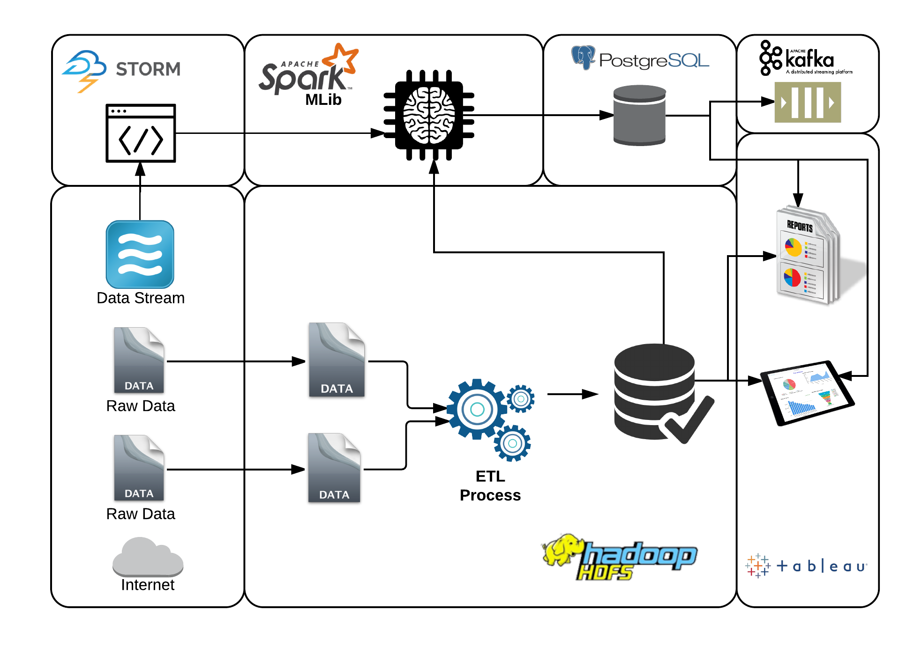
Data Architecture

Slide 5
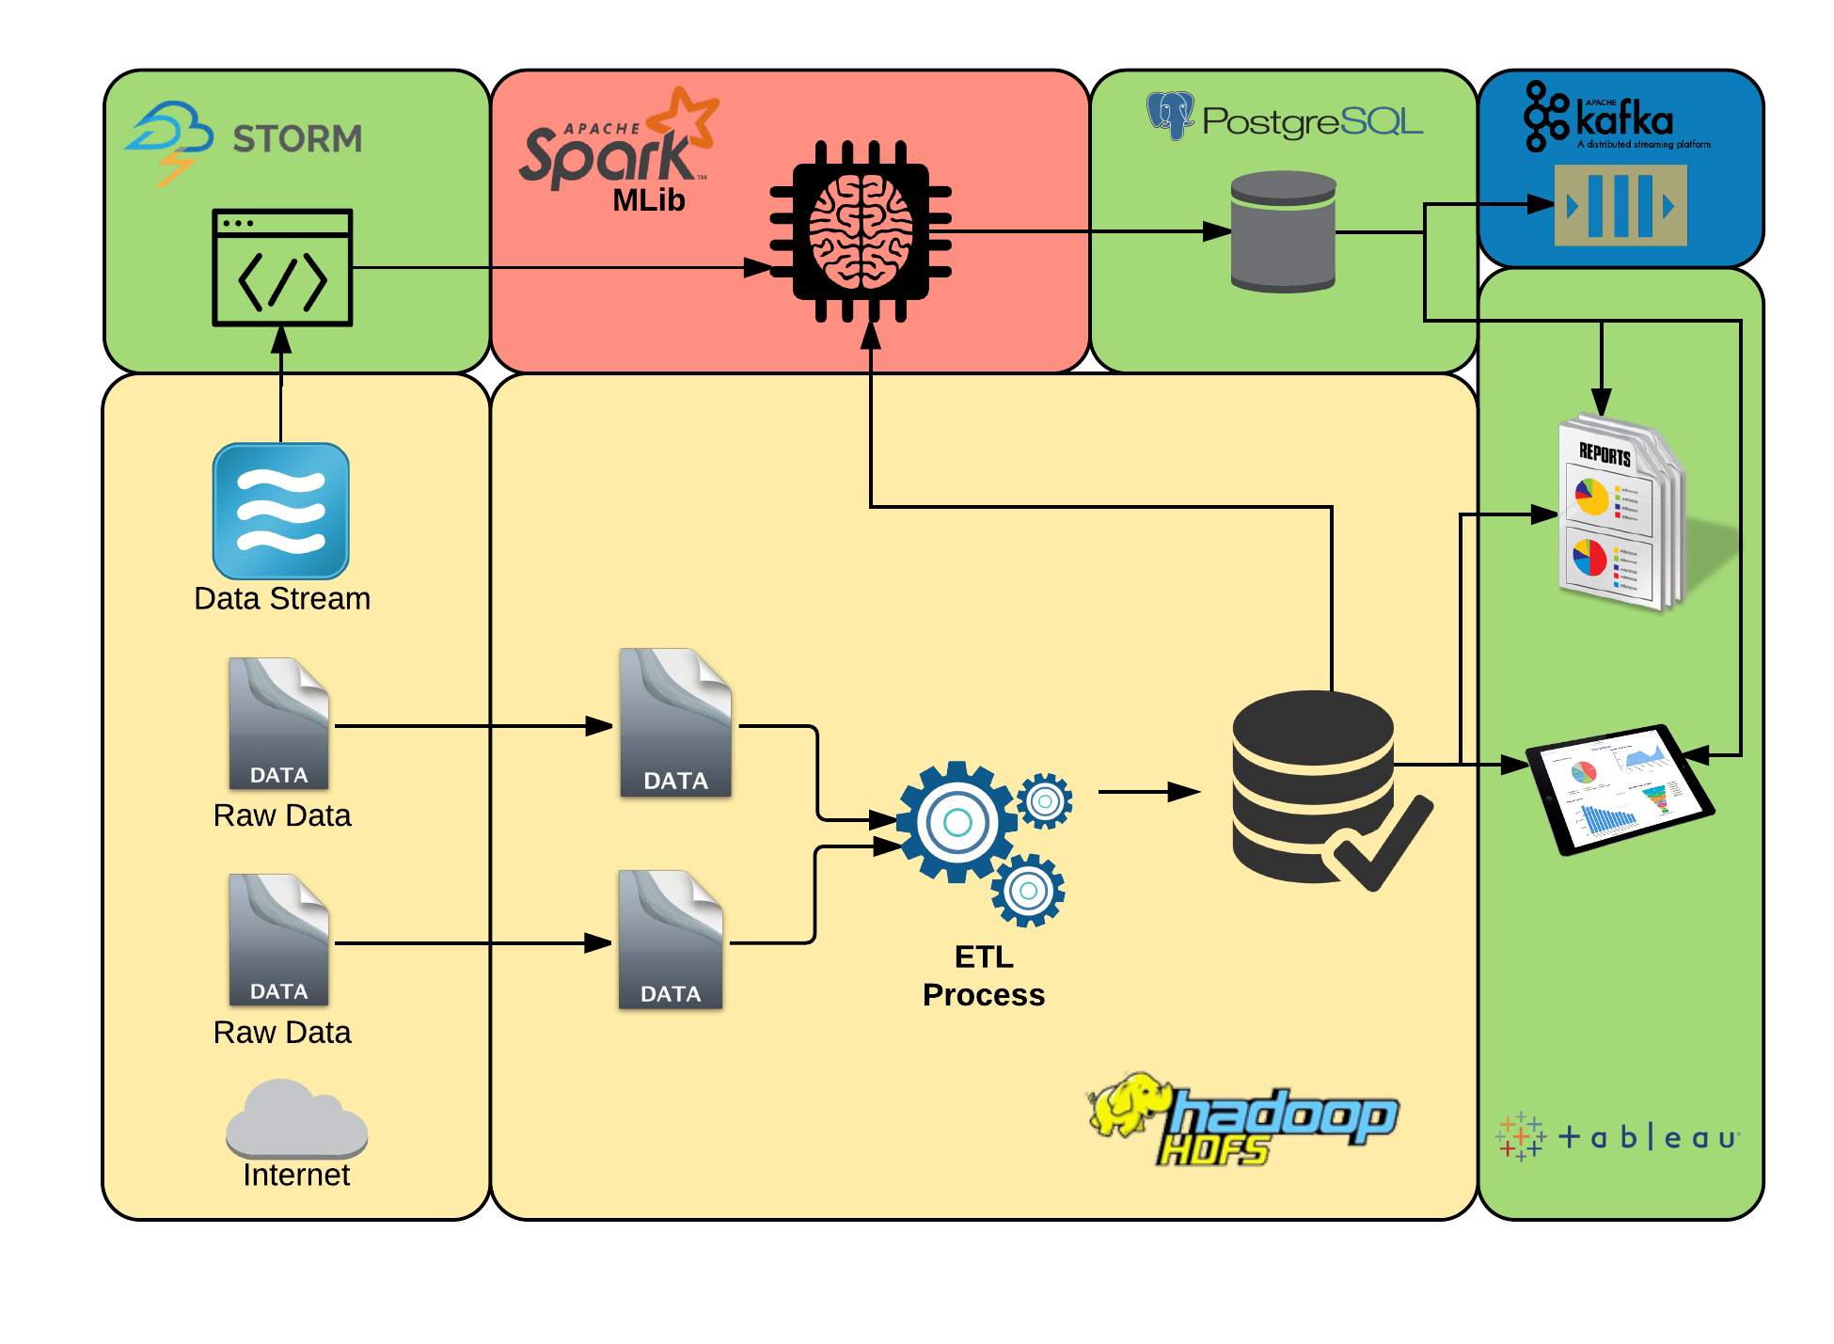
Data Architecture - Phased Implementation
Phase 1
Phase 2
Phase 3
Phase 4

Slide 6
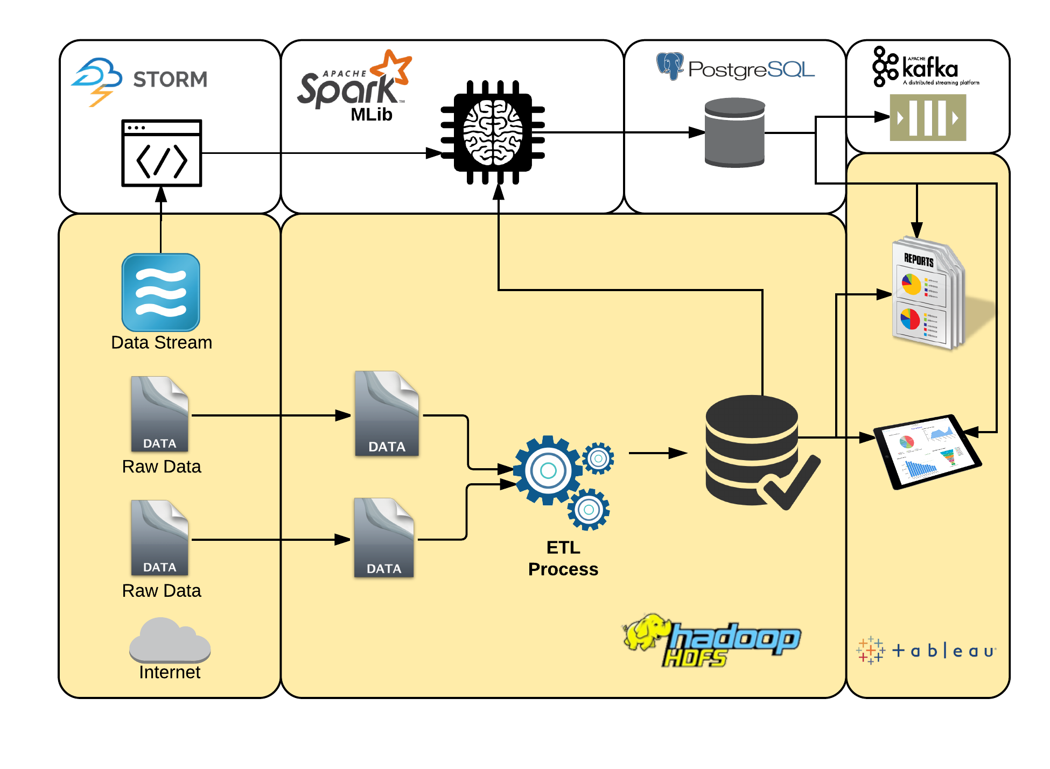
Data Architecture - Implementation Phase 1

Slide 7
Data Architecture - Implementation Phase 1
Completed Tasks
Data lake loading script
Ongoing
Historic data visualizations
Data formatting for visualizations and machine learning
Research and gathering of new data sources to enrich the dataset

Slide 8
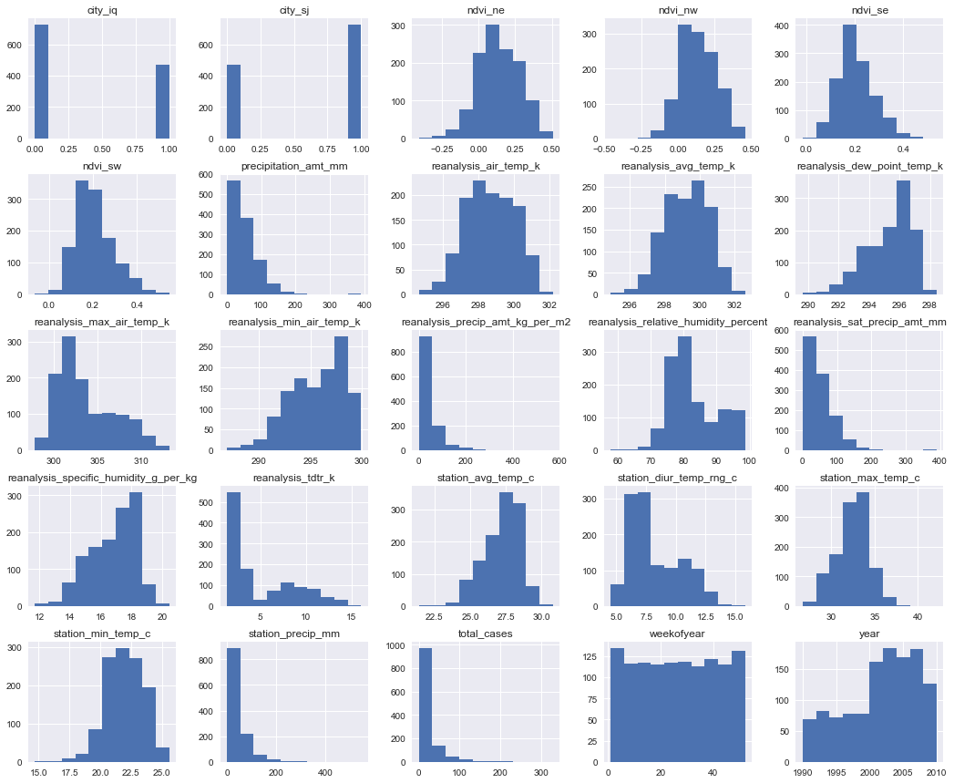
Data Visualization
Completed Tasks
Data Cleaning/Formatting
Python Scripts for Initial Data Exploration
Ongoing
Python Data Exploration fine tuning and advanced analysis
Machine Learning Algorithms

Slide 9
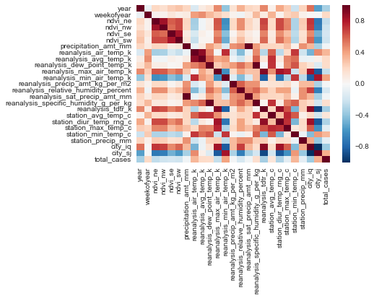
Data Viz.
Correlation Heat Map

Slide 10
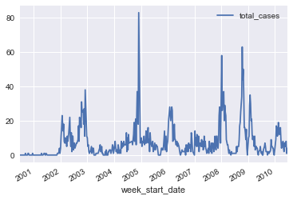
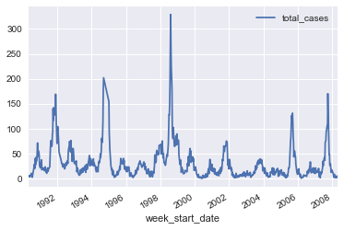
Data Viz.
Iquitos
San Juan

Slide 11
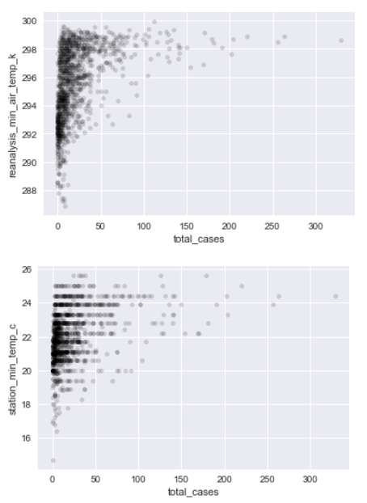
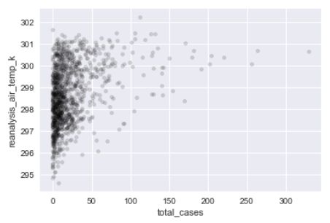
Data Viz.
Highly correlated variables to total_cases

